Slide 1
MIDDLETON CHENEY
FOOTBALL CLUB

Slide 2
FIRST TEAM
1948-49
SEASON
OXFORD JUNIOR LEAGUE
AND CUPS

Slide 3
April 16th 1949
Byfield Bethel Cup Final Played at Byfield
Woodford Central 0 v 3 Middleton
A. Turvey
H. Gibbard
B. Merry
S. Baker
L. Fortnum (Capt)
G. Merrivale Goal Scorer G. Barnes
F. Bidwell F. Bidwell
R. Christie J. Christie
T. Barnes
J. Christie
G. Barnes
Ref Mr T A Barford

Slide 4
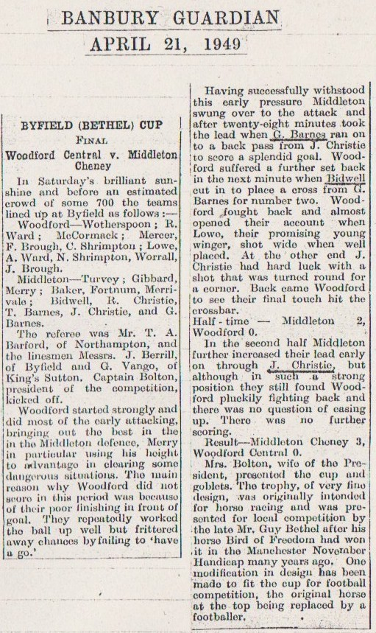

Slide 5
April 23rd 1949
Brackley (Myers) Charity Cup Final Played at Brackley
Brackley 2 v 1 Middleton
A. Turvey
H. Gibbard
B. Merry
S. Baker
L. Fortnum (Capt)
G. Merrivale Goal Scorer T. Barnes
F. Bidwell
R. Christie
T. Barnes
J. Christie
G. Barnes
Ref

Slide 6
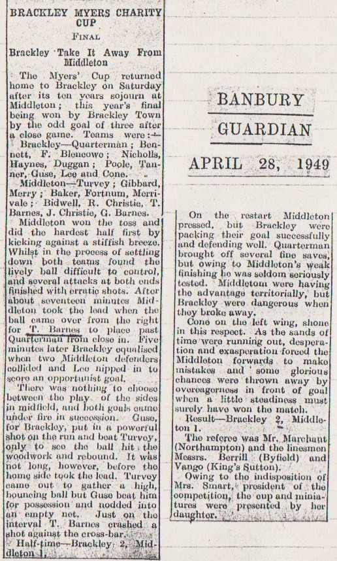

Slide 7
April 30th 1949
Buckingham Charity Cup Final Played at Buckingham
Buckingham 3 v 1 Middleton
A. Turvey
H. Gibbard
B. Merry
S. Baker
L. Fortnum (Capt)
G. Merrivale Goal Scorer L. Fortnum
F. Bidwell
Brain
T. Barnes
Skeates
G. Barnes
Ref

Slide 8
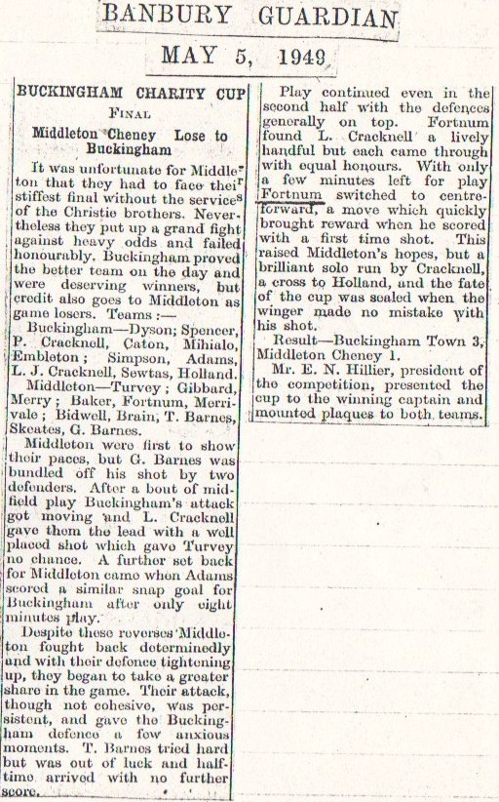

Slide 9
May 14th 1949
Banbury Guardian Cup Final Played Spencer Stadium
Cropredy 4 v 3 Middleton
A. Turvey
H. Gibbard
B. Merry
S. Baker
L. Fortnum (Capt)
G. Merrivale Goal Scorer T. Barnes
F. Bidwell L. Fortnum
R. Christie H. Gibbard (Pen)
T. Barnes
J. Christie
G. Barnes
Ref Mr L. Harris

Slide 10
